Slide 1
methods
a method is a function that is declared with a receiver

Slide 2
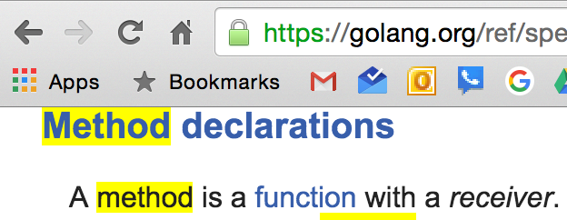
methods
a method is a function that is declared with a receiver

Slide 3
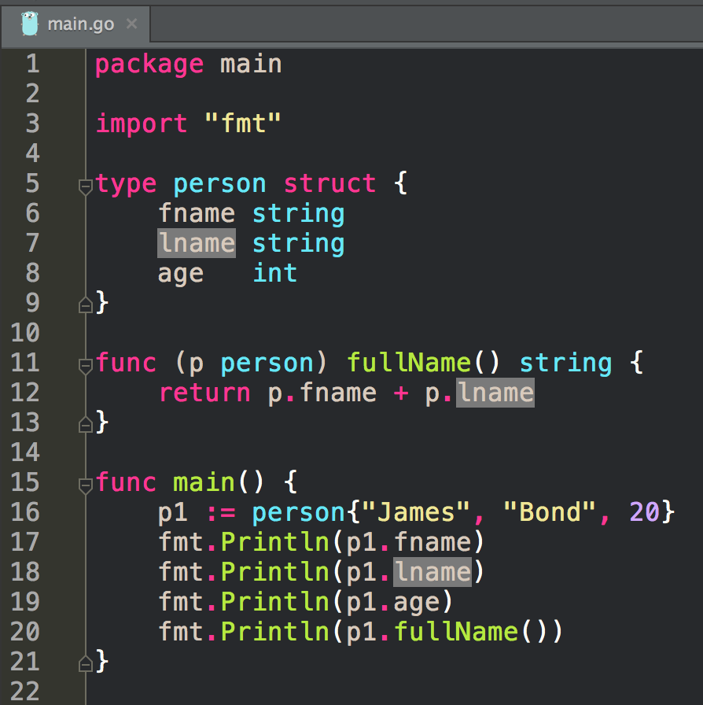
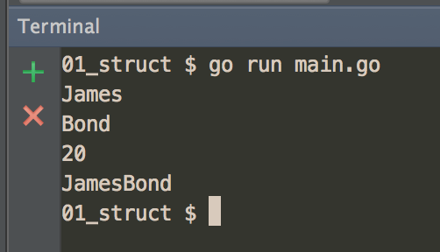
receiver

Slide 4
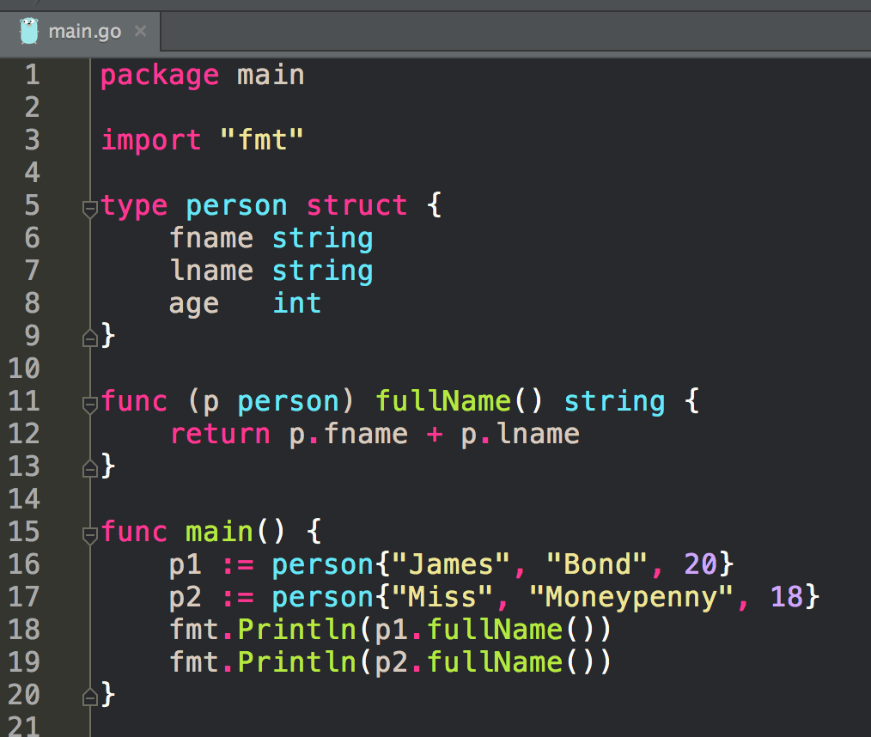
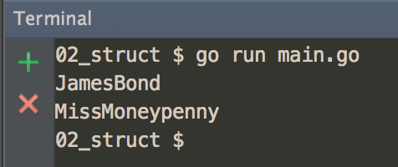
receiver

Slide 5
Receivers
There are two types of receivers:
value
pointer

Slide 6
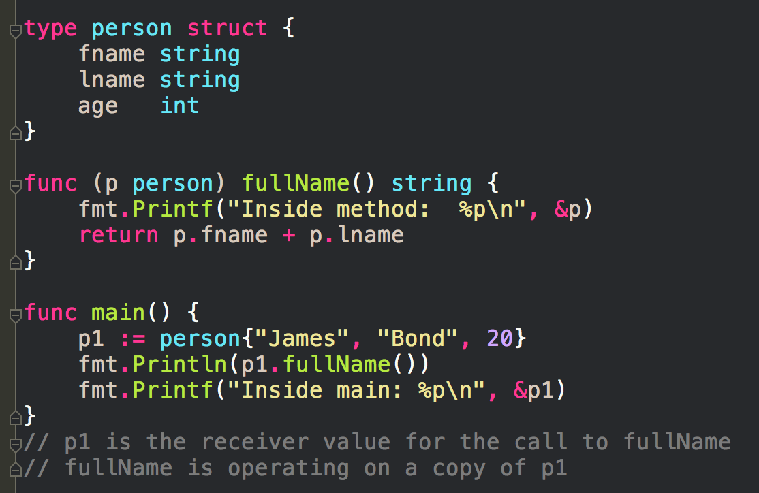
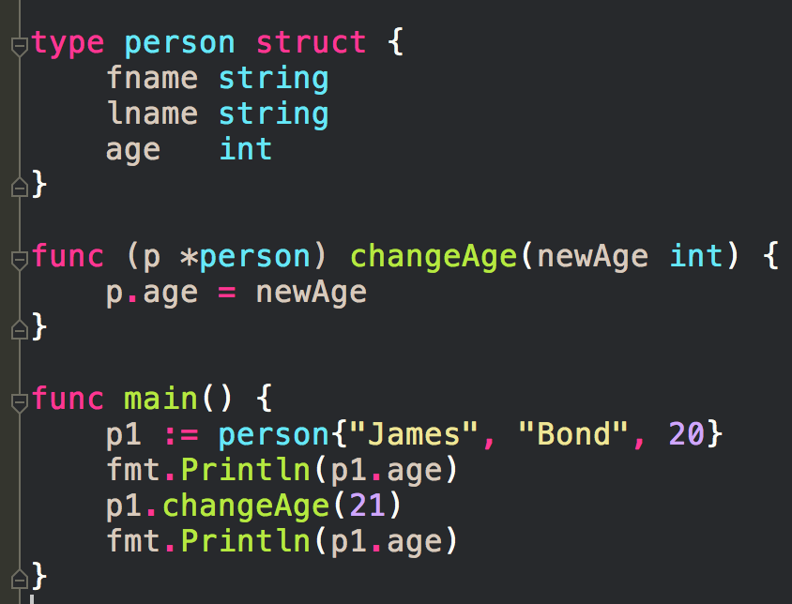
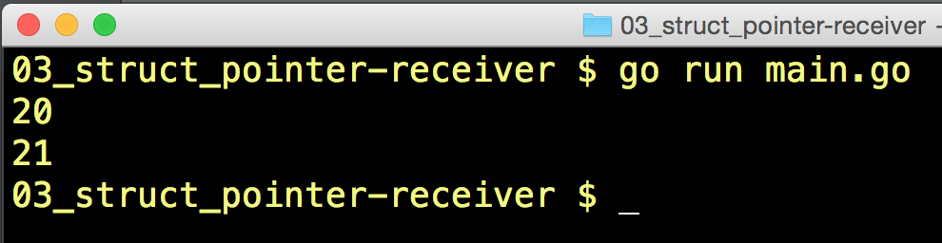
Receivers
operate on a copy of the value used to make the method call
There are two types of receivers:
value
pointer
operate on the actual value used to make the method call

Slide 7
Receivers
Which one should you use?
There are two types of receivers:
value
you don’t need to change the value making the method call
pointer
you need to change the value making the method call

Slide 8
a type’s nature
a type’s nature should dictate how you use it

Slide 9
Primitive Types
Pass a Copy
Golang by default includes several pre-declared, built-in, primitive types
boolean
numeric
string
primitive types
Pass a copy, the actual value; not a reference pointer

Slide 10
Reference Types
Pass a Copy
reference types
point to some underlying data structure
Reference types
slice
map
channel
interface
function
Header Value
When we declare a reference type, the value that is created is a header value. The header value contains a pointer to an underlying data structure. Do not use pointers with reference types. Pass a copy; the actual value. The actual value already has a reference pointer to the underlying data structure. When you give a copy of the actual value, that copy also is a pointer to the same underlying data structure. Both the copy, and the original, point to the same underlying data structure.

Slide 11
Struct Types
Depends
Use
value
if you don’t need to change the value
can also convey semantic meaning
eg, Time pkg
time is immutable
pointer
if you need to change the value
typically used with structs

Slide 12
Struct Types
Depends
Use
value
if you don’t need to change the value
can also convey semantic meaning
eg, pkg time
time is immutable
pointer
if you need to change the value
typically used with structs
eg, *Files in pkg os
We could say this has a primitive nature
We could say this has a non-primitive nature

Slide 13
a type’s nature
a type’s nature should dictate how you use it

Slide 14
In most cases, struct types don’t exhibit a primitive nature but a nonprimitive one. In these cases, adding or removing something from the value of the type should mutate the value. When this is the case, we want to use a pointer to share the value with the rest of the program that needs it. … [ Examples: ] … When you think about time, you realize that any given point in time is not something that can change. This is exactly how the standard library implements the Time type. … Since values of type File have a non-primitive nature, they are always shared and never copied.
~William Kennedy

Slide 16
The decision to use a value or pointer receiver should not being based on whether the method is mutating the receiving value. The decision should be based on the nature of the type. One exception to this guideline is when you need the flexibility that value type receivers provide when working with interface values. In these cases, you may choose to use a value receiver even though the nature of the type is nonprimitive. It’s entirely based on the mechanics behind how interface values call methods for the values stored inside of them.
~William Kennedy

Slide 20
Resources
Understanding Golang Type System
Ardan Labs Blog Post

Slide 21
exercise
write a program
that uses a method

Slide 22
embedded types

Slide 23
“Go’s type system does not support inheritance. In Go, composition is preferred over inheritance where type embedding is the way to implement composition. Many pragmatic developers are proponents of using composition over inheritance.”
~ this great article

Slide 24
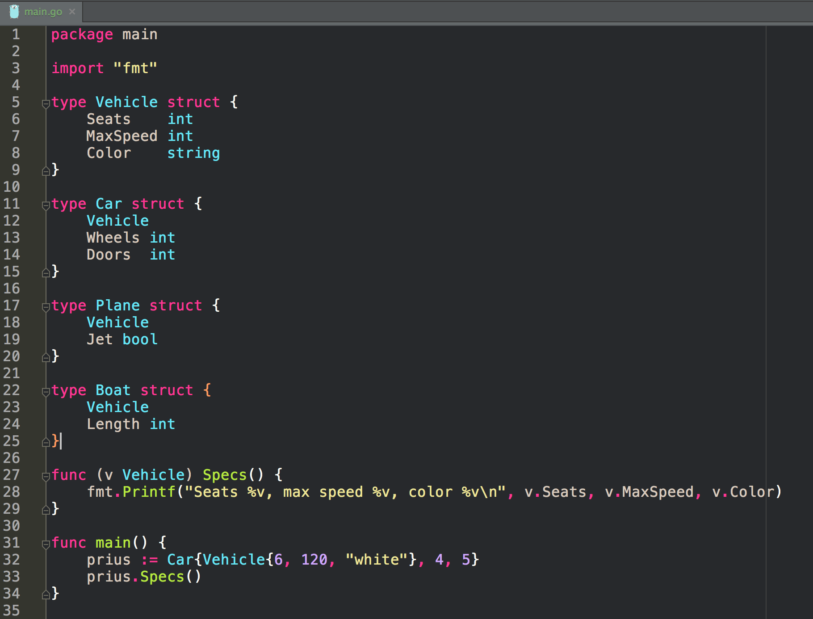
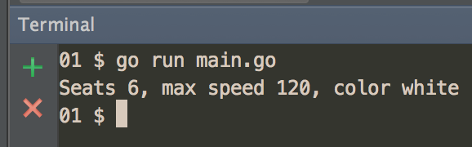
Embedded type

Slide 25
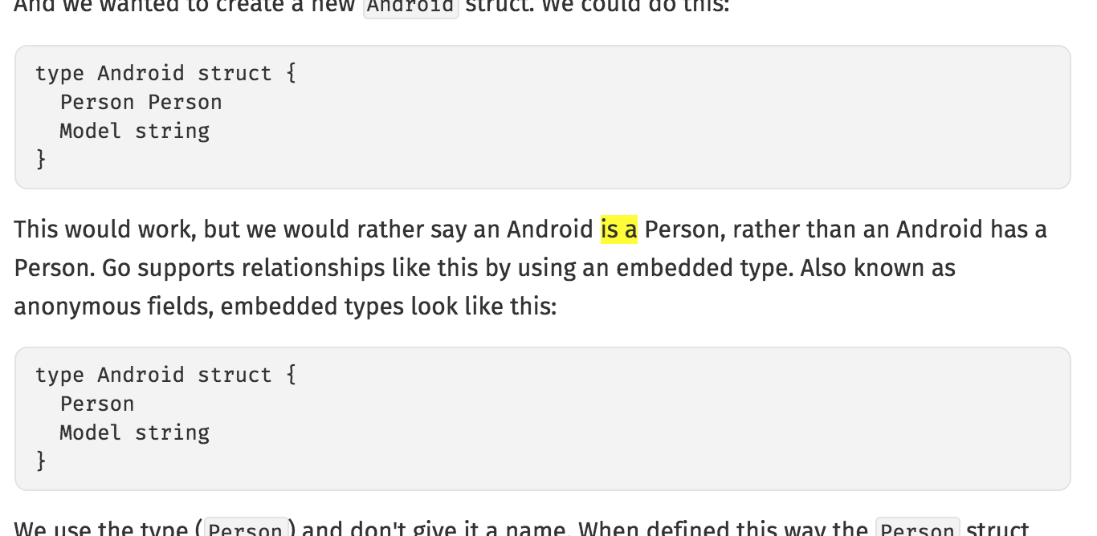
not this way
this way
http://www.golang-book.com/books/intro/9

Slide 26
exercise
write a program
that uses an embedded type

Slide 27
Review
methods
receivers
embedded types
composition vs. inheritance

